Slide 1
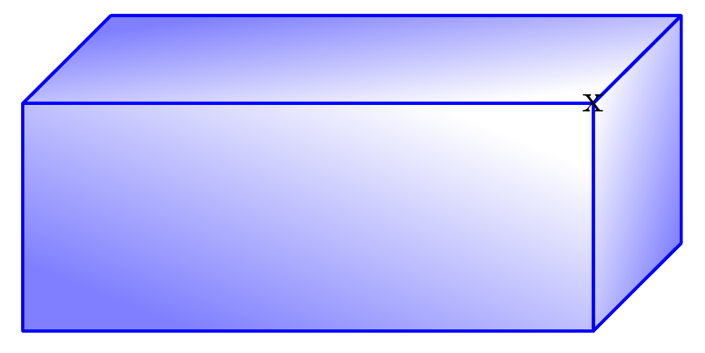
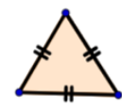
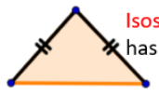

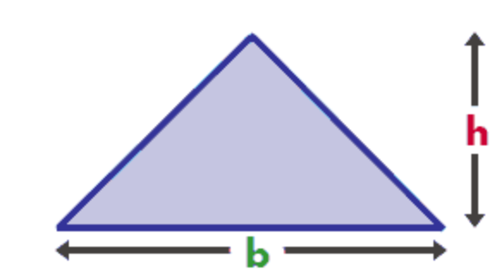
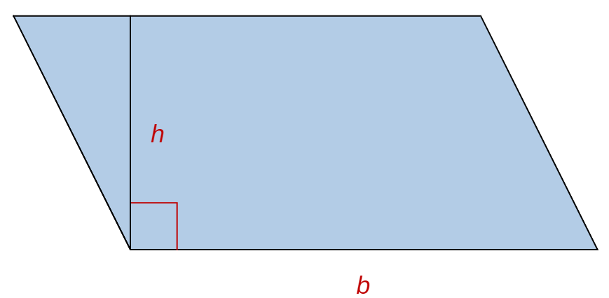
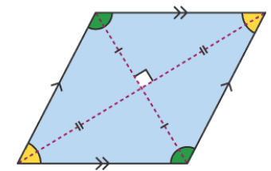
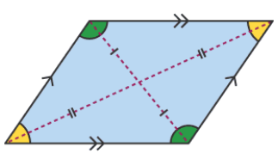
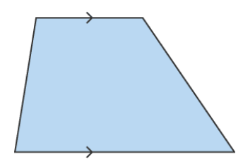

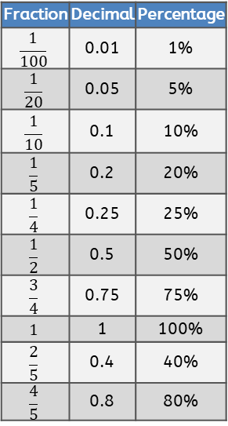
Due to font size (10pt), we recommend printing this page at A3 size
if possible.
Measurement Conversions
1cm | 10mm
1m | 100cm
1km | 1,000m
1 mile | 1.6km
1km | 0.625 (5/8 mile)
1kg | 1,000 grams
1 litre | 1,000 millilitres
Full turn | 360º
Half turn | 180º
Right angle | 90º
Acute angle | <90º
Obtuse angle | <180º
Reflex angle | >180º
Angle on a straight line | 180º
Angles inside a triangle | 180º
Angles inside a quadrilateral | 360º
Term | Definition | Example
factor | A number that divides exactly into another number | Factors of 12: 1, 2, 3, 4 , 6, 12
common factor | Factors of two numbers that are the same | Common factors of 8 and 12: 1, 2 and 4
prime number | A number with exactly two factors | 2, 3, 5, , 11 , 13, 17, 19…
composite number | A number with more than two factors | 12 (as it has six factors)
prime factor | A factor that is prime | Prime factors of 12: 2, 3
multiple | A number that is in another number’s times table | Multiples of 9: 9, 18, 27, 36…
common multiple | Multiples of two numbers that are the same | Common multiples of 4 and 6: 12,24…
square numbers | A result when a number has been multiplied by itself | 25 (52 = 5x5) 49 (72 = 7x7)
cube numbers | When a number has been multiped by itself three times | 8 (23 = 2x2x2) 27 (33 = 3x3x3)
Volume of a Cuboid
length x width x height
height
width
length
Equilateral | Isosceles | Scalene | Right angled
3 equal sides and 3 angles of 60° | 2 equal sides and 2 equal angles | No equal sides or angles | One angle is a right angle (90°)
Name | Sides
quadrilateral | 4
pentagon | 5
hexagon | 6
heptagon | 7
octagon | 8
nonagon | 9
Decagon | 10
Roman Numerals
1 | I
5 | V
10 | X
50 | L
100 | C
500 | D
1,000 | M
Shape Vocabulary
Fraction | Decimal | Percentage
$$\frac{1}{100}$$ | 0.01 | 1%
$$\frac{1}{20}$$ | 0.05 | 5%
$$\frac{1}{10}$$ | 0.1 | 10%
$$\frac{1}{5}$$ | 0.2 | 20%
$$\frac{1}{4}$$ | 0.25 | 25%
$$\frac{1}{2}$$ | 0.5 | 50%
$$\frac{3}{4}$$ | 0.75 | 75%
$$1$$ | 1 | 100%
$$\frac{2}{5}$$ | 0.4 | 40%
$$\frac{4}{5}$$ | 0.8 | 80%
Month | Days
January | 31 days
February | 28 days
March | 31 days
April | 30 days
May | 31 days
June | 30 days
July | 31 days
August | 31 days
September | 30 days
October | 31 days
November | 30 days
December | 31 days
1 year = 365 days Leap year = 366 days
Area of a triangle
(base x height) ÷ 2
Area of a parallelogram
base x height (Height = perpendicular height)
Perpendicular lines (at a right angle)
Vertical line
Parallelogram | Rhombus | Trapezium
Two pairs of parallel sides | All sides have the same length and are parallel | One pair of parallel sides
radius
Horizontal
line
diameter (radius x2)
Parallel lines
Perimeter = measure around the edge
Circumference = perimeter of a circle

